Slide 1
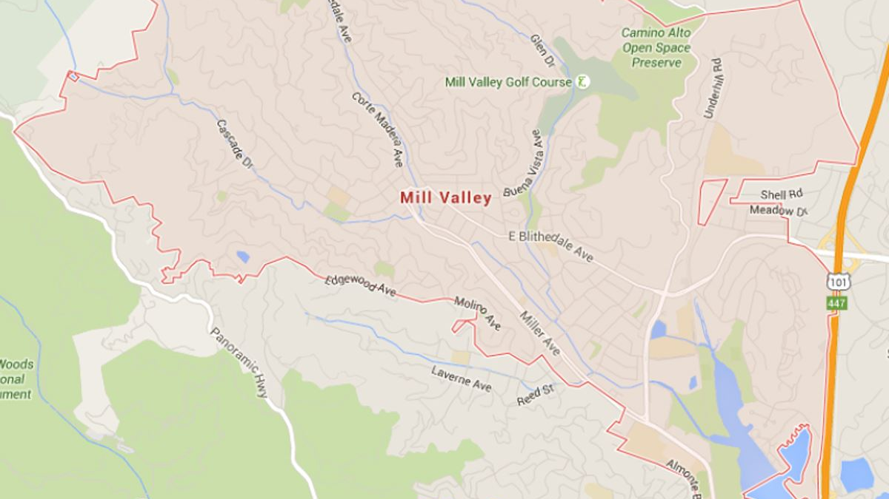
MILL VALLEY 2022 CURRENT & PROPOSED
ASSISTED FAMILY HOUSING INVENTORY
100% LOCATED EAST OF CAMINO ALTO
FAMILY
Alto Station
17 Units
Proposed
1 Hamilton 40+ Units
FAMILY Shelter Hill 75 Units
FAMILY Pickleweed32 Units

Slide 2
MILL VALLEY 2022 CURRENT & PROPOSED
ASSISTED SENIOR/DISABLED HOUSING INVENTORY
92% LOCATED EAST OF CAMINO ALTO
SENIOR / DISABLED
Kruger Pines
56 Units
DISABLED
Camino Alto Apts
24 Units
Proposed
1 Hamilton 40+ Units
DISABLED
Mill Creek Apts
9 Units
SENIOR / DISABLED
Homestead
28 Units
SENIOR / DISABLED
The Redwoods
149/60 Units

